Slide 1

Q.W.A.C.K.
Quizzes, Worksheets, And Competition Kit
© qwack education- 2022

Slide 2
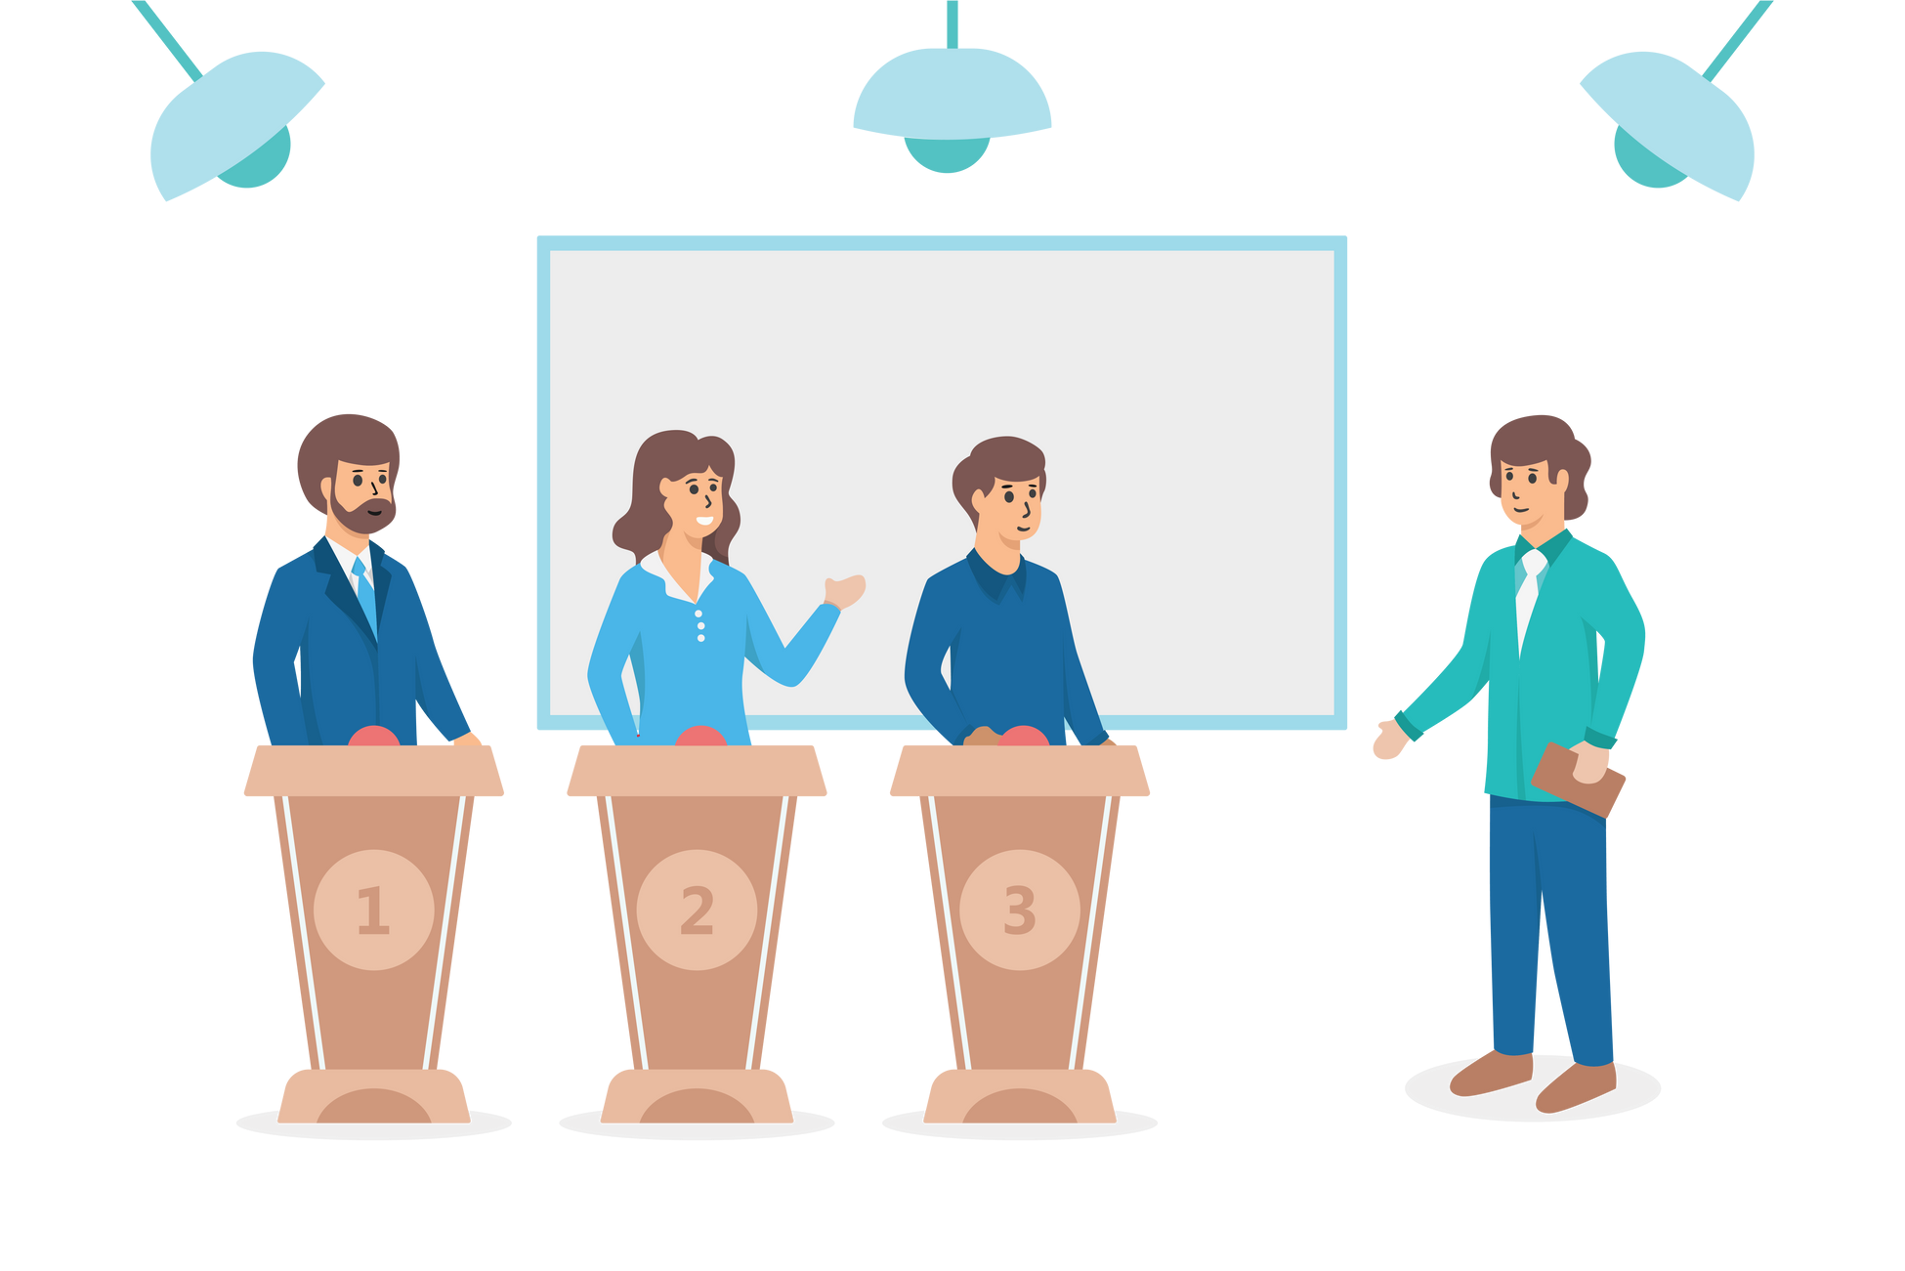



About Q.W.A.C.K. Education
In today’s modern time, everything is just one click away, online Education platform in India has brought a revolutionary change. Not only they have made
learning easy for students but also reduced the stress for the parents as well. Q.W.A.C.K. Education is a website-based Ed-tech that purely focuses on English Grammar at the current stage. It will have various
Quizzes
features with innovative learning and practice methodologies, our website will have features like Quizzes, Worksheets, Vocabulary, and Competitions which will offer a highly personalized and effective Practicing & learning Place currently for classes 1 - 7,
It will have learning with fun as it's the main focus.
Competition
Vocabulary
© qwack education- 2022
Worksheet

Slide 3
The Problem
We plan to solve.
->
Lack of grammar skills in children
->
Differences in education boards
Even though most of the students are studying in an English medium school, they are not confident about communicating or
Even if students want to practice Grammar, the state board schools are not very well equipped with the material for Grammar practice. And when the schools refer to
giving a speech in English. They lack Grammar skills and are out of words while communicating.
International Publication for practice for Grammar, students cannot solve because they lack their basic knowledge in Grammar
->
Grammar feels boring and plain
->
Grammar is a neglected area
There is no integrated approach for practicing and learning with Fun, particularly in the Grammar field.
Students always take gramar lightly which directly impacts overall their writing and speaking skills

Slide 4
The Solutions
We will provide.
->
Q.W.A.C.K. education website will provide an integrated solution for all the problems mentioned before. It will have various
->
The content will be divided into two levels which are Elementary and
Intermediate. Now students can practice and learn Grammar topics from the Basic Stage.
features like Concept Practice Worksheets,
Worksheets, Competition
Games, Quizzes, and Vocabulary.
->
Our website will offer a solution to parents who are searching for Grammar-related information and Vocabulary-related information for their children.
->
No student worksheets
likes to on their
solve the own. But if
there is an element of losing or winning, the students are more interested to perform better.

Slide 5

VISION
Our Vision is a community where all children feel loved, respected and encouraged to develop to their fullest potential.

Slide 6

MISION
Using technology to connect students with the world around them to prepare them for better future.

Slide 7




Our Values
We believe that a happy child is a successful one. We are committed to providing a positive, safe and stimulating environment for children to learn, where all are valued. We intend that all children should enjoy their learning, achieve their potential and become independent life-long learners.

Slide 8
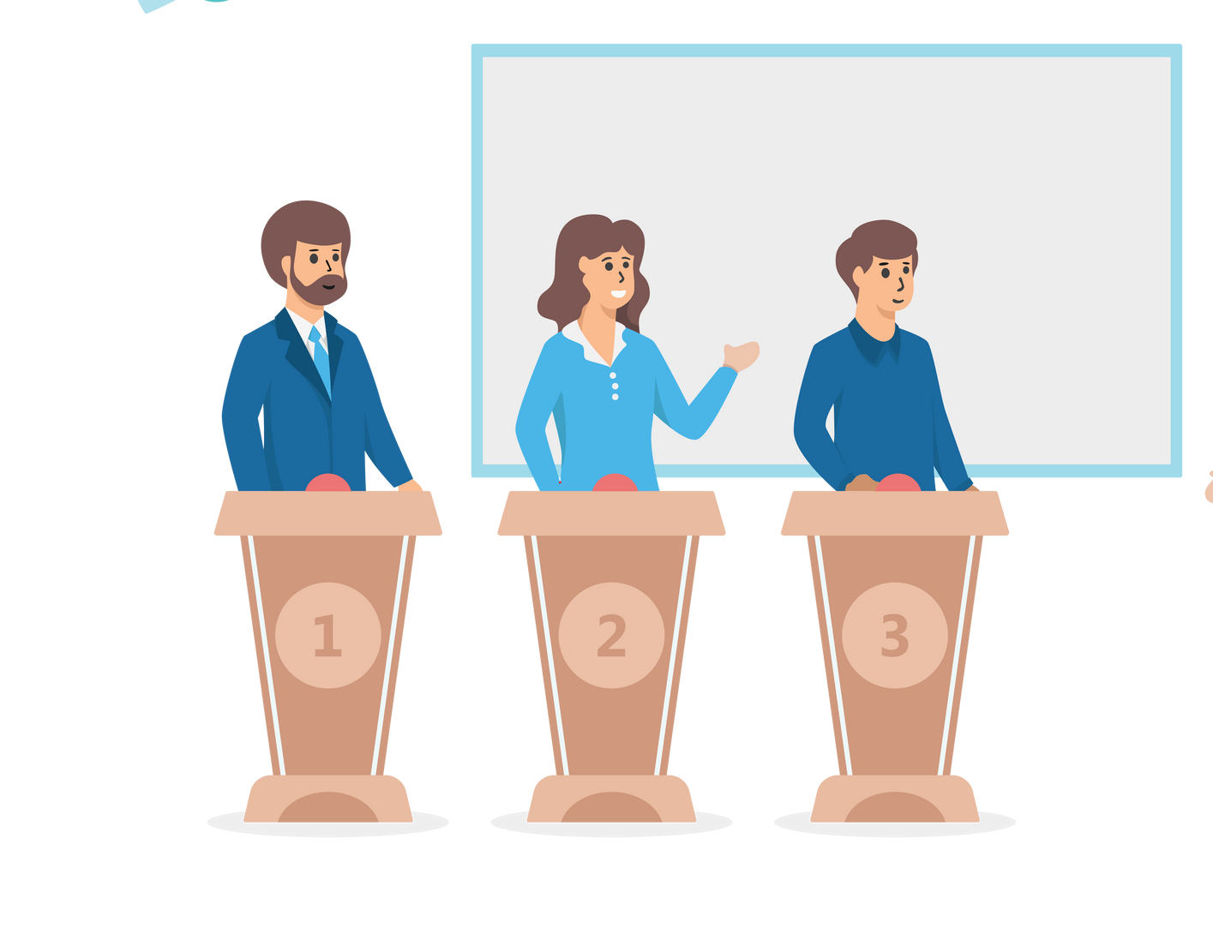

Quizzes
Worksheets
OUR FEATURES
Our website will consist of many
Q.W.A.C.K. education will
It is a great platform for kids to clear concepts with concept
organize a National level Quiz on monthly basis. Any student can participate and they can check where they stand on a
worksheets and practice more
with Practice worksheets crafted with the best efforts
national level with timed quizzes.
from our team.
features grammar practice
which help make fun and enjoyable to
Vocabulary
Q.W.A.C.K. education will have a Vocabulary section in which day in and day out students will learn new words with the practical use of the word.
Competition
Q.W.A.C.K. EDUCATION website will have a Competition section that is purely focused on Grammar, here students can participate in these Grammar games with their friends by inviting them.

Slide 9



OUR TARGET AUDIENCE
We aspire to reach everyone in need of grammar resources
Children in their learning age
Teachers who want better resources
Parents who need any assistance in their child's learning growth
www.reallygreatsite.com

Slide 10
What we will create for this challenge
For this challenge, we will create the competition section of our WebApp.
In this section, children will be able to create a private room for free and connect and practice grammar with their friends, so that we enable kids from small cities to smart cities to learn and practice an invaluable skill with multiple pre-built levels created specifically for more practice by our hard-working content team
Practice will now no more be boring as competition Games will bring a sense of learning from playing Games.

Slide 11
Why did we opt for this challenge?
-> To enable the kids who don't have proper resources to be able to learn and educate themselves.
-> Not only the kids from small cities and rural areas but also the children in urban areas are not able to communicate properly, and the reason is a lack of grammar resources
-> We realized that other education platforms are very costly and many middle-class and lower-class demographic of India can not afford them, Hence we will provide top-level content at extremely low prices.

Slide 12
Difficulty Control
Individual topics
Children will be able to practice grammar topics Individually. so that they
SPECIAL
It will have two difficulty modes namely- Elementry Intermediate
FEATURES
and so that the
can be used by age
can either topics they
product different difficulty
concentrate on
The competition section will
features to
groups
without
know or explore new topics
consist of multiple
make our website more interactive and attractive
Free for all equal for all
We as portrayed want to reach kids and parents from all the regions of society. and to achieve that we will keep this section of our webApp free for all
Multiple
question types
The competition sections will be enabled with different types of questions like - drag and
the
drop questions, fill in
blanks, MCQs and more

Slide 13




How we will achieve this?
Our tech stack

Slide 14

How we will achieve this?
Our tech stack
Backend:
we will use Node.js® which is a JavaScript runtime built on Chrome's V8 JavaScript engine. We will also use its open- source modules. thanks to azure app services we will be able to deploy it on azure with ease as it has many pre-
built functionalities.

Slide 15

Our tech stack
Frontend:
Our frontend will be a react based app with a lot of
functionalities like drag and drop questions, fun, and interactive UI to bring people
Database:
We will be using MongoDB deployed on Cosmos DB which is the best NoSQL deplyoment option available.

Slide 16
Meet Our
Skilled Team
Darshan Kothari
A 5th Year Law Student.
Having almost 4-5 years of experience in
Tutoring in the Grammar field. I have been teaching students of State Board and ICSE boards from Grade 2 to Grade 7.
Janki Thekdi
A commerce graduate having almost 5-7 years of experience in the teaching field. I
have been teaching students of CBSE/ ICSE boards from grade 5th to 10th classes.
Reedham Pujara
The tech guy
After being in the field for almost 3 years now and building multiple small projects
I am now ready to build something big that will bring a change in the society

Slide 17
THANKS FOR WATCHING
and giving us a chance in the competition
“Grammar is the greatest joy in life, don’t you find?”
-Daniel Handler
We will help you find it.
+91 7016 664 182
Coming soon on www.qwackedu.com
contact@qwackedu.com

Slide 18
THANKS FOR WATCHING
and giving us a chance in the competition
Any suggestions and/or changes are highly
appreciated
+91 7016 664 182
Coming soon on www.qwackedu.com
contact@qwackedu.com

